Slide 1
Cloud Practice - Bengaluru
Presenter | Sandeep Sachan
19th June 2017

Slide 2
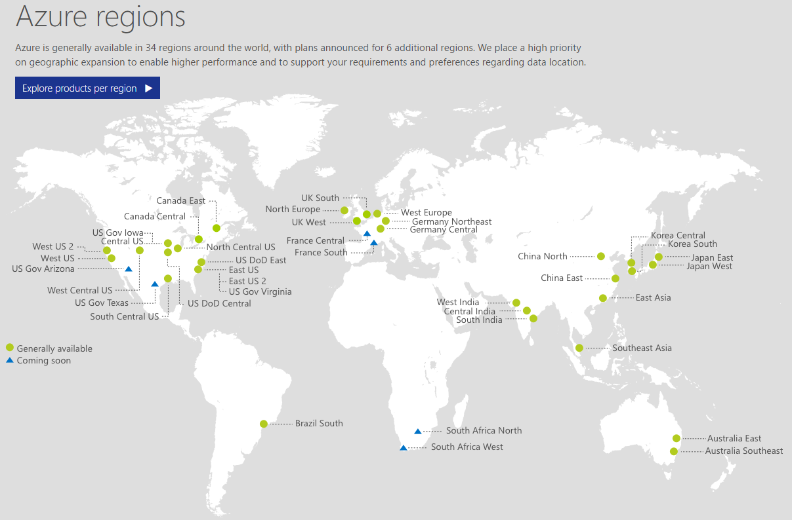

Slide 3

What we know?
Compute
Storage
Virtual Machines
Networks

Slide 4
Introduction to Azure app services and application insights

Slide 5
Features of app services
Auto Scaling
Staging Environments
Continuous Deployment
Virtual Networking
Isolated / Dedicated Environments

Slide 6
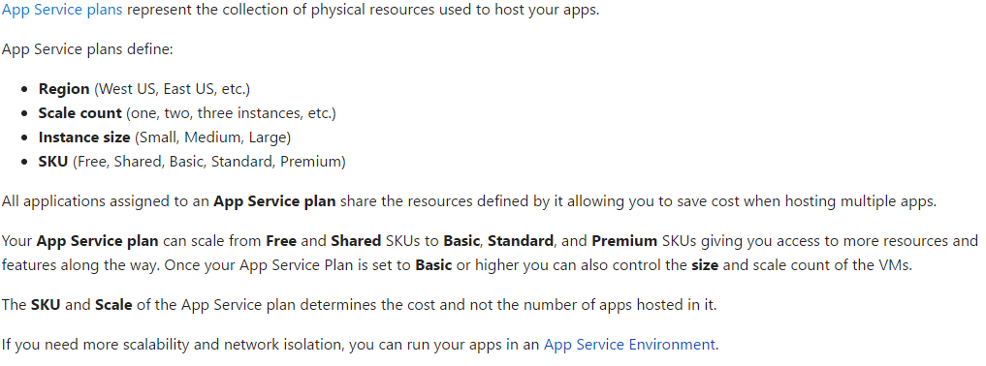
App Service Plan

Slide 7
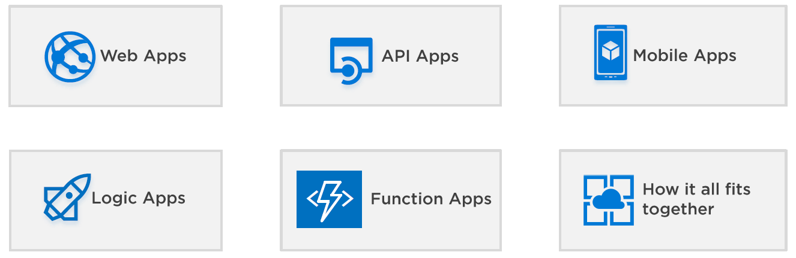
Services

Slide 8

Web Application (web app)
Multiple languages and frameworks
DevOps optimization
Global scale with high availability
Connections to SaaS platforms and on-premises data
Security and compliance
Visual Studio integration
Reference: https://docs.microsoft.com/en-us/azure/app-service-web/app-service-web-overview

Slide 9
Web Application (web app)
Demo
Deployment Slot
WebJobs
Reference: https://docs.microsoft.com/en-us/azure/app-service-web/app-service-web-overview

Slide 10

API Application (api app)
Bring your existing API as-is
Easy consumption
Simple access control
Visual Studio integration
Integration with Logic Apps
https://docs.microsoft.com/en-us/azure/app-service-api/app-service-api-apps-why-best-platform

Slide 11
API Application (api app)
Demo
https://docs.microsoft.com/en-us/azure/app-service-api/app-service-api-apps-why-best-platform

Slide 12

Mobile Application (api app)
Authentication and Authorization
Data Access
Offline Sync
Push Notifications
Client SDKs
https://docs.microsoft.com/en-us/azure/app-service-mobile/app-service-mobile-value-prop

Slide 13
Mobile Application (api app)
Demo
https://docs.microsoft.com/en-us/azure/app-service-mobile/app-service-mobile-value-prop

Slide 14

Logic Application (logic app)
Workflow
Managed Connectors
Triggers
Actions
Enterprise Integration Pack
https://docs.microsoft.com/en-us/azure/app-service-mobile/app-service-mobile-value-prop

Slide 15
Logic Application (logic app)
Demo
https://docs.microsoft.com/en-us/azure/app-service-mobile/app-service-mobile-value-prop

Slide 16

Application Insight (app insight)
Application map
Diagnostic search for instance data
Metrics Explorer for aggregated data
Live Metrics Stream
REST API
Continuous export
https://docs.microsoft.com/en-us/azure/application-insights/app-insights-overview

Slide 17
Application Insight (app insight)
Demo
https://docs.microsoft.com/en-us/azure/application-insights/app-insights-overview

Slide 18
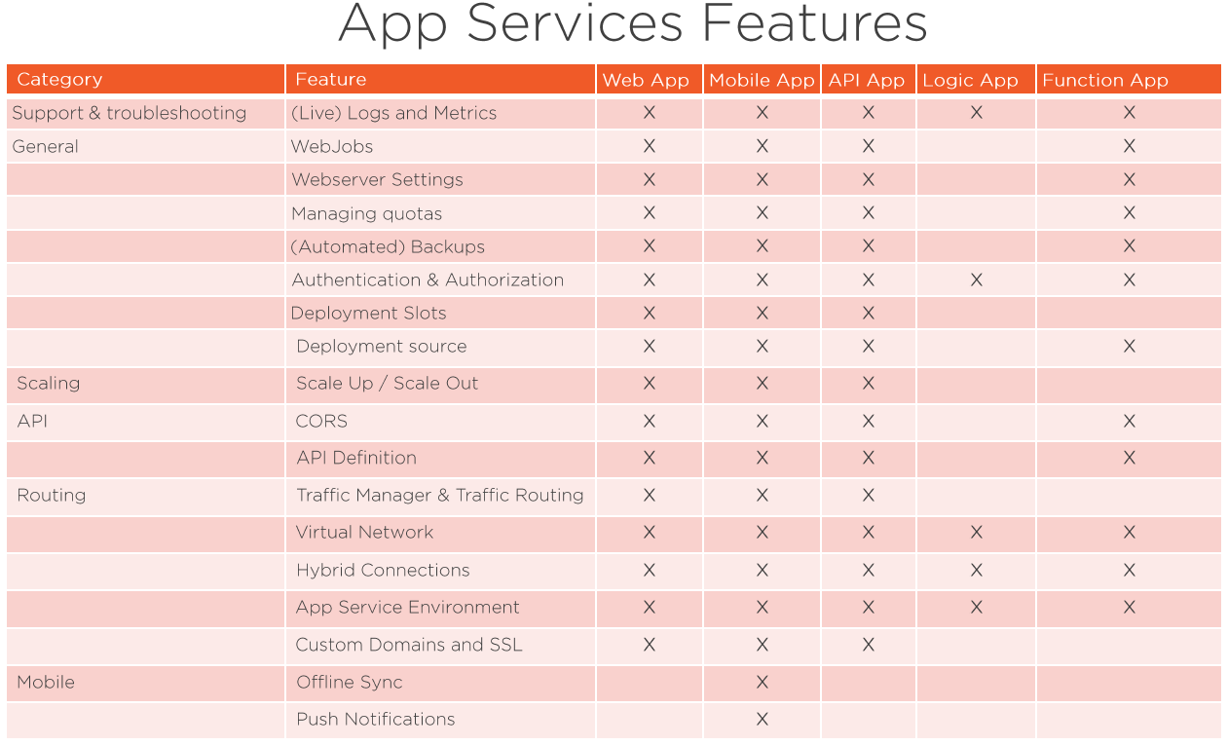

Slide 19
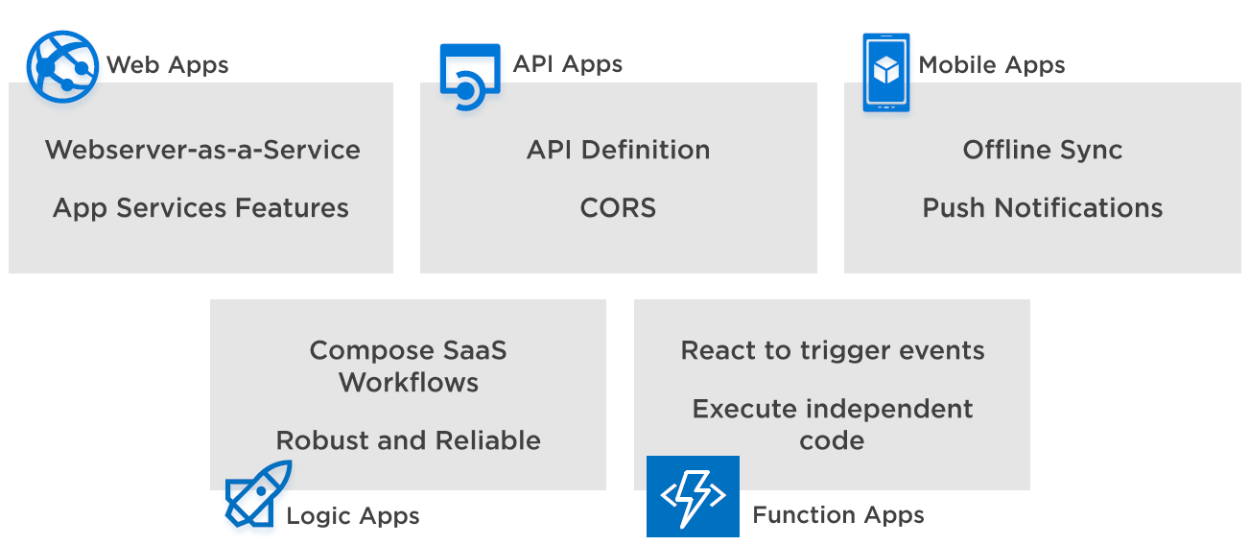
Mix and match

Slide 20
